Slide 1
TASK 3

Slide 2
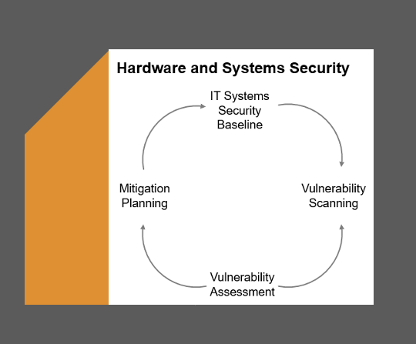
Graphic Representation

Slide 3
In order to build an overall Hardware and Systems Security, it starts with an IT System Security Baseline which defines the theoretical to-be state. By scanning or similar testing measures, the data for a vulnerability assessment is gathered. The as-is configuration of the organisation’s asset is compared to known vulnerabilities and to the baseline. Differences will then be subject to mitigation planning, in order to get as close as possible to the baseline.

Slide 4
Notes Explaining Relationships
Information Systems Security Baseline:
This is the foundational framework that defines the minimum-security measures for protecting an organization’s information systems. It is crucial because it sets the standard for security practices and helps ensure that all systems are secured consistently.
Vulnerability Assessment:
This process involves identifying, quantifying, and prioritizing vulnerabilities in the system. It provides essential information that informs the security baseline, ensuring that it addresses current threats.
Vulnerability Scanning:
This is a specific technique used to detect vulnerabilities in hardware and software. Regular vulnerability scanning is integral to maintaining an up-to-date security baseline because it automates the detection of known vulnerabilities and highlights areas requiring immediate attention.
Mitigation Planning:
After vulnerabilities are identified, mitigation planning outlines how to address these weaknesses. This step is critical for enhancing the security baseline, as it translates the findings from assessments and scans into actionable strategies to reduce risk.
Hardware and Systems Security:
This aspect focuses on securing the physical devices and systems that house sensitive data. Ensuring hardware security is part of maintaining a comprehensive security baseline, as it prevents unauthorized access and reduces physical vulnerabilities.

Slide 5
Conclusion
Summary: Emphasize the importance of maintaining an up-to-date Information Systems Security Baseline and the need for regular assessments, scans, and mitigation planning to ensure robust security.
Call to Action: Encourage the Head of IT Infrastructure to commit to a schedule for regular vulnerability assessments and updates to the security baseline.

Slide 6
THANK YOU

